Slide 1
SQ3R

Slide 2
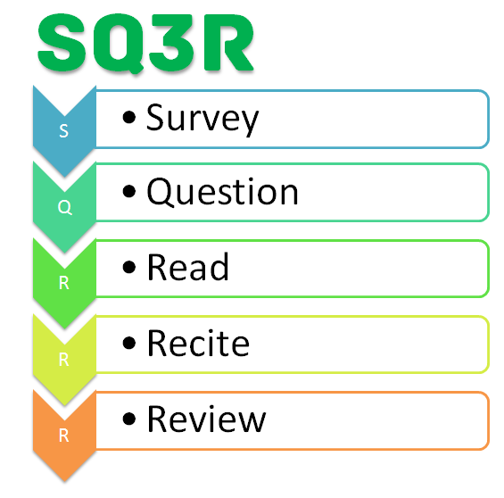

Slide 3
Survey
This step helps you gather the information that is necessary to focus on the chapter and formulate questions for yourself as you read. It’s not necessary to have answers to your questions at this step in the process – answers will come later.
Read the title
This helps your brain begin to focus on the topic of the chapter.
Read the introduction and/or summary
This orients you to how this chapter fits the author’s purposes. It also provides you with an overview of the author’s statement of the most important points.
Read each boldface heading and subheading
This helps you to create a framework for the chapter in your mind before you begin reading. This framework provides a structure for the thoughts and details to come.
Review any graphics
Charts, maps, diagrams, pictures, and other visual aids are there to make a point. Publishers will not include these items in textbooks unless they significantly add to the content of the text.
Review any reading aids in the chapter
This includes italics, chapter objectives, definitions, and study questions at the end of the chapter. These aids are there to help you sort, comprehend, and remember the material.

Slide 4
Question
Now that you have surveyed the entire chapter and built a framework for understanding, it is time to begin the reading process. This step and the next two, reading and reciting, are repeated over and over as you read the chapter.
Turn boldface headings into one or more questions. Write those questions on the left third of a piece of paper.
As you read this section, you will be looking for the answer to your questions. For example, if you are reading a book to help you improve your study skills and the heading is "Use a Regular Study Area," the questions you might ask are, "Why should I have a regular study area?" and "Where should my regular study area be located?"
Why is this step necessary?
When your mind is actively searching for answers to questions, it becomes engaged in the learning process. This will help you remember and understand the information.

Slide 5
Read
Read one section at a time
As you read each section, look for the answers to your questions and write them down in your own words on the right two-thirds of your piece of paper.
Add more questions, if necessary
A single question is probably adequate for a section that is only a few paragraphs long; however, for longer sections, you may find that you need to add a question or two.
Don’t get bogged down with the details
Well-written textbooks often provide examples to further explain main ideas. As you read each section, try to separate the details from the main ideas. Use the details to help you understand the main ideas but don't expect yourself to memorize every detail provided in the chapter.

Slide 6
Recite
Reciting material as you go retrains your mind to concentrate and learn as you read. When you can answer your questions about the section that you’re reading, move to the next section and repeat the question, read, recite process again. Use this for every section in the chapter
When do you recite?
At the end of each section.
How do you recite?
Look at the question(s) you wrote down before you read the section. Cover your answers with a piece of paper and see if you can answer the questions from memory.
What if you can’t recall the answers to your questions?
Reread the section, or the part of the section, that has to do with that question.

Slide 7
Review
The review step helps to refine your mental organization of the material in the chapter and begin to build memory – we learn through repetition. This step provides another opportunity for repetition of the material and therefore will enhance your recall of the information.
How do you review?
Once you've finished reading the entire chapter, using the survey, question, read, and recite steps, go back over all of your questions. Cover the answers to the questions that you’ve written down and see if you can still recite them.
What if some of the answers have been forgotten?
Reread that section of the chapter to refresh your memory, recite the answer after you've written it down, and then continue your review process.

