Slide 1
Social Hierarchy in the Roman Empire

Slide 2
Emperors
Social
Hierarchy

Slide 3
Emperors
Patricians & Senators
Social
Hierarchy

Slide 4
Emperors
Patricians & Senators
Equestrians
Social
Hierarchy

Slide 5
Emperors
Patricians & Senators
Equestrians
Plebeians
Social
Hierarchy

Slide 6
Emperors
Patricians & Senators
Equestrians
Plebeians
Soldiers & Freedmen
Social
Hierarchy

Slide 7
Emperors
Patricians & Senators
Equestrians
Plebeians
Soldiers & Freedmen
Women, Gladiators & Slaves
Social
Hierarchy

Slide 8
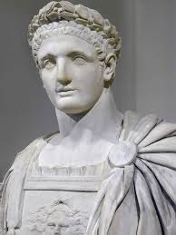
Emperor
Absolute ruler of the ____________…lived in style in
the best ______,eating the best ____and wearing the
best _______. He had lots of ______and ________.

Slide 9
Emperor
Absolute ruler of the Roman Empire…lived in style in
the best ____, eating the best ____and wearing the
best _______. He had lots of ______and ________.

Slide 10
Emperor
Absolute ruler of the Roman Empire…lived in style in
the best villas, eating the best ____and wearing the
best _______. He had lots of ______and ________.

Slide 11
Emperor
Absolute ruler of the Roman Empire…lived in style in
the best villas, eating the best food and wearing the
best _____. He had lots of ______and ________.

Slide 12
Emperor
Absolute ruler of the Roman Empire…lived in style in
the best villas, eating the best food and wearing the
best clothes. He had lots of ______and ________.

Slide 13
Emperor
Absolute ruler of the Roman Empire…lived in style in
the best villas, eating the best food and wearing the
best clothes. He had lots of power and ________.

Slide 14
Emperor
Absolute ruler of the Roman Empire…lived in style in
the best villas, eating the best food and wearing the
best clothes. He had lots of power and authority.

Slide 15
Emperor
Absolute ruler of the Roman Empire…lived in style in
the best villas, eating the best food and wearing the
best clothes. He had lots of power and authority.
The emperor’s family lived the life of the ____ and
______…they spent time with favorite pastimes, like
music, poetry, hunting, and horse racing.

Slide 16
Emperor
Absolute ruler of the Roman Empire…lived in style in
the best villas, eating the best food and wearing the
best clothes. He had lots of power and authority.
The emperor’s family lived the life of the rich and
______…they spent time with favorite pastimes, like
music, poetry, hunting, and horse racing.

Slide 17
Emperor
Absolute ruler of the Roman Empire…lived in style in
the best villas, eating the best food and wearing the
best clothes. He had lots of power and authority.
The emperor’s family lived the life of the rich and
famous…they spent time with favorite pastimes, like
music, poetry, hunting, and horse racing.

Slide 18
Emperor
Absolute ruler of the Roman Empire…lived in style in
the best villas, eating the best food and wearing the
best clothes. He had lots of power and authority.
The emperor’s family lived the life of the rich and famous…they spent
time with favorite pastimes, like music, poetry, hunting, and horse racing.
Emperors were not chosen on the basis of their ability or _______, but
simply because they were born into the ____________.

Slide 19
Emperor
Absolute ruler of the Roman Empire…lived in style in
the best villas, eating the best food and wearing the
best clothes. He had lots of power and authority.
The emperor’s family lived the life of the rich and famous…they spent
time with favorite pastimes, like music, poetry, hunting, and horse racing.
Emperors were not chosen on the basis of their ability or honesty, but
simply because they were born into the ____________.

Slide 20
Emperor
Absolute ruler of the Roman Empire…lived in style in
the best villas, eating the best food and wearing the
best clothes. He had lots of power and authority.
The emperor’s family lived the life of the rich and famous…they spent
time with favorite pastimes, like music, poetry, hunting, and horse racing.
Emperors were not chosen on the basis of their ability or honesty, but
simply because they were born into the right family.

Slide 21
Emperor
Absolute ruler of the Roman Empire…lived in style in
the best villas, eating the best food and wearing the
best clothes. He had lots of power and authority.
The emperor’s family lived the life of the rich and famous…they spent
time with favorite pastimes, like music, poetry, hunting, and horse racing.
Emperors were not chosen on the basis of their ability or honesty, but
simply because they were born in the right family.
But there was still drama…the throne could be passed to ________,
stepsons, or even favored courtiers, and sometimes heirs had to be
approved by the ______. As a result, royal palaces were constantly filled
with political plots and ____________.

Slide 22
Emperor
Absolute ruler of the Roman Empire…lived in style in
the best villas, eating the best food and wearing the
best clothes. He had lots of power and authority.
The emperor’s family lived the life of the rich and famous…they spent
time with favorite pastimes, like music, poetry, hunting, and horse racing.
Emperors were not chosen on the basis of their ability or honesty, but
simply because they were born in the right family.
But there was still drama…the throne could be passed to brothers,
stepsons, or even favored courtiers, and sometimes heirs had to be
approved by the ______. As a result, royal palaces were constantly filled
with political plots and ____________.

Slide 23
Emperor
Absolute ruler of the Roman Empire…lived in style in
the best villas, eating the best food and wearing the
best clothes. He had lots of power and authority.
The emperor’s family lived the life of the rich and famous…they spent
time with favorite pastimes, like music, poetry, hunting, and horse racing.
Emperors were not chosen on the basis of their ability or honesty, but
simply because they were born in the right family.
But there was still drama…the throne could be passed to brothers,
stepsons, or even favored courtiers, and sometimes heirs had to be
approved by the Senate. As a result, royal palaces were constantly filled
with political plots and ____________.

Slide 24
Emperor
Absolute ruler of the Roman Empire…lived in style in
the best villas, eating the best food and wearing the
best clothes. He had lots of power and authority.
The emperor’s family lived the life of the rich and famous…they spent
time with favorite pastimes, like music, poetry, hunting, and horse racing.
Emperors were not chosen on the basis of their ability or honesty, but
simply because they were born in the right family.
But there was still drama…the throne could be passed to brothers,
stepsons, or even favored courtiers, and sometimes heirs had to be
approved by the Senate. As a result, royal palaces were constantly filled
with political plots and conspiracies.

Slide 25
Emperors
Patricians & Senators
Social
Hierarchy

Slide 26
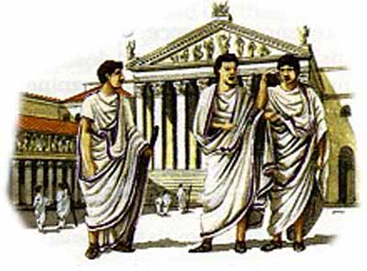
Patricians
Ranked just ______the emperor and his relatives, the
patrician families ___________Rome and its empire. These
families provided the empire’s ___________, _________, and
________leadership.

Slide 27
Patricians
Ranked just below the emperor and his relatives, the
patrician families _____________Rome and its empire.
These families provided the empire’s ___________,
_________, and _______leadership.

Slide 28
Patricians
Ranked just below the emperor and his relatives, the
patrician families dominated Rome and its empire.
These families provided the empire’s ___________,
_________, and ________leadership.

Slide 29
Patricians
Ranked just below the emperor and his relatives, the
patrician families dominated Rome and its empire.
These families provided the empire’s political,
_________, and ________leadership.

Slide 30
Patricians
Ranked just below the emperor and his relatives, the
patrician families dominated Rome and its empire.
These families provided the empire’s political,
religious, and ________leadership.

Slide 31
Patricians
Ranked just below the emperor and his relatives, the
patrician families dominated Rome and its empire.
These families provided the empire’s political,
religious, and military leadership.

Slide 32
Patricians
Ranked just below the emperor and his relatives, the
patrician families dominated Rome and its empire.
These families provided the empire’s political, religious,
and military leadership.
Most patricians were _____________________from old families, but the class was open to a
chosen few who had been deliberately __________by the emperor.

Slide 33
Patricians
Ranked just below the emperor and his relatives, the
patrician families dominated Rome and its empire.
These families provided the empire’s political, religious,
and military leadership.
Most patricians were wealthy landowners from old families, but the class was open to a
chosen few who had been deliberately __________by the emperor.

Slide 34
Patricians
Ranked just below the emperor and his relatives, the
patrician families dominated Rome and its empire.
These families provided the empire’s political, religious,
and military leadership.
Most patricians were wealthy landowners from old families, but the class was open to a
chosen few who had been deliberately promoted by the emperor.

Slide 35
Patricians
Ranked just below the emperor and his relatives, the
patrician families dominated Rome and its empire.
These families provided the empire’s political, religious,
and military leadership.
Most patricians were wealthy landowners from old families, but the class was open to a
chosen few who had been deliberately promoted by the emperor.
They were ________ as young men for leadership, learning poetry and literature, history and
geography.

Slide 36
Patricians
Ranked just below the emperor and his relatives, the
patrician families dominated Rome and its empire.
These families provided the empire’s political, religious,
and military leadership.
Most patricians were wealthy landowners from old families, but the class was open to a
chosen few who had been deliberately promoted by the emperor.
They were educated as young men for leadership, learning poetry and literature, history and
geography.

Slide 37
Patricians
Ranked just below the emperor and his relatives, the
patrician families dominated Rome and its empire.
These families provided the empire’s political, religious,
and military leadership.
Most patricians were wealthy landowners from old families, but the class was open to a
chosen few who had been deliberately promoted by the emperor.
They were educated as young men for leadership, learning poetry and literature, history and
geography.
The patrician class enjoyed special __________: its members were excused from some ________
duties expected of other citizens, and only patricians could become ________.

Slide 38
Patricians
Ranked just below the emperor and his relatives, the
patrician families dominated Rome and its empire.
These families provided the empire’s political, religious,
and military leadership.
Most patricians were wealthy landowners from old families, but the class was open to a
chosen few who had been deliberately promoted by the emperor.
They were educated as young men for leadership, learning poetry and literature, history and
geography.
The patrician class enjoyed special privileges: its members were excused from some ________
duties expected of other citizens, and only patricians could become ________.

Slide 39
Patricians
Ranked just below the emperor and his relatives, the
patrician families dominated Rome and its empire.
These families provided the empire’s political, religious,
and military leadership.
Most patricians were wealthy landowners from old families, but the class was open to a
chosen few who had been deliberately promoted by the emperor.
They were educated as young men for leadership, learning poetry and literature, history and
geography.
The patrician class enjoyed special privileges: its members were excused from some military
duties expected of other citizens, and only patricians could become ________.

Slide 40
Patricians
Ranked just below the emperor and his relatives, the
patrician families dominated Rome and its empire.
These families provided the empire’s political, religious,
and military leadership.
Most patricians were wealthy landowners from old families, but the class was open to a
chosen few who had been deliberately promoted by the emperor.
They were educated as young men for leadership, learning poetry and literature, history and
geography.
The patrician class enjoyed special privileges: its members were excused from some military
duties expected of other citizens, and only patricians could become emperor.

Slide 41
Patricians
Ranked just below the emperor and his relatives, the
patrician families dominated Rome and its empire.
These families provided the empire’s political, religious,
and military leadership.
Most patricians were wealthy landowners from old families, but the class was open to a
chosen few who had been deliberately promoted by the emperor.
They were educated as young men for leadership, learning poetry and literature, history and
geography.
The patrician class enjoyed special privileges: its members were excused from some military
duties expected of other citizens, and only patricians could become emperor.
Being a patrician carried its own _______: patricians could find themselves becoming
wrapped up in palace _____ for power. If they lost, they could lose their _____ and even
their _____.

Slide 42
Patricians
Ranked just below the emperor and his relatives, the
patrician families dominated Rome and its empire.
These families provided the empire’s political, religious,
and military leadership.
Most patricians were wealthy landowners from old families, but the class was open to a
chosen few who had been deliberately promoted by the emperor.
They were educated as young men for leadership, learning poetry and literature, history and
geography.
The patrician class enjoyed special privileges: its members were excused from some military
duties expected of other citizens, and only patricians could become emperor.
Being a patrician carried its own dangers: patricians could find themselves becoming
wrapped up in palace _____ for power. If they lost, they could lose their _____ and even
their _____.

Slide 43
Patricians
Ranked just below the emperor and his relatives, the
patrician families dominated Rome and its empire.
These families provided the empire’s political, religious,
and military leadership.
Most patricians were wealthy landowners from old families, but the class was open to a
chosen few who had been deliberately promoted by the emperor.
They were educated as young men for leadership, learning poetry and literature, history and
geography.
The patrician class enjoyed special privileges: its members were excused from some military
duties expected of other citizens, and only patricians could become emperor.
Being a patrician carried its own dangers: patricians could find themselves becoming
wrapped up in palace plots for power. If they lost, they could lose their _____ and even
their _____.

Slide 44
Patricians
Ranked just below the emperor and his relatives, the
patrician families dominated Rome and its empire.
These families provided the empire’s political, religious,
and military leadership.
Most patricians were wealthy landowners from old families, but the class was open to a
chosen few who had been deliberately promoted by the emperor.
They were educated as young men for leadership, learning poetry and literature, history and
geography.
The patrician class enjoyed special privileges: its members were excused from some military
duties expected of other citizens, and only patricians could become emperor.
Being a patrician carried its own dangers: patricians could find themselves becoming
wrapped up in palace plots for power. If they lost, they could lose their homes and even
their _____.

Slide 45
Patricians
Ranked just below the emperor and his relatives, the
patrician families dominated Rome and its empire.
These families provided the empire’s political, religious,
and military leadership.
Most patricians were wealthy landowners from old families, but the class was open to a
chosen few who had been deliberately promoted by the emperor.
They were educated as young men for leadership, learning poetry and literature, history and
geography.
The patrician class enjoyed special privileges: its members were excused from some military
duties expected of other citizens, and only patricians could become emperor.
Being a patrician carried its own dangers: patricians could find themselves becoming
wrapped up in palace plots for power. If they lost, they could lose their homes and even
their lives.

Slide 46
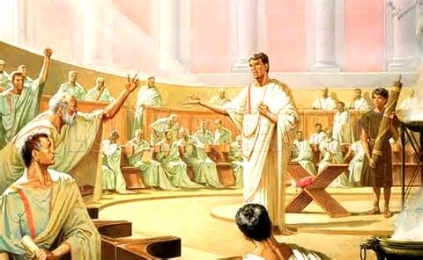
Senators
The Roman Senate started
as an _________________, filled
entirely with ______________, when Rome was under _______. By the last two
centuries of the republic, however, it had become much more powerful
and a major player in politics and government.

Slide 47
Senators
The Roman Senate started
as an advisory council, filled
entirely with ______________, when Rome was under _______. By the last two
centuries of the republic, however, it had become much more powerful
and a major player in politics and government.

Slide 48
Senators
The Roman Senate started
as an advisory council, filled
entirely with patricians, when Rome was under _______. By the last two
centuries of the republic, however, it had become much more powerful
and a major player in politics and government.

Slide 49
Senators
The Roman Senate started
as an advisory council, filled
entirely with patricians, when Rome was under kings. By the last two
centuries of the republic, however, it had become much more powerful
and a major player in politics and government.

Slide 50
Senators
The Roman Senate started
as an advisory council, filled
entirely with patricians, when Rome was under kings. By the last two
centuries of the republic, however, it had become much more powerful
and a major player in politics and government.
Once Rome became an empire, senators held much _____ power than they
did in the past, although the Senate still had some _________ power, and
occasionally decided who would become emperor.

Slide 51
Senators
The Roman Senate started
as an advisory council, filled
entirely with patricians, when Rome was under kings. By the last two
centuries of the republic, however, it had become much more powerful
and a major player in politics and government.
Once Rome became an empire, senators held much less power than they
did in the past, although the Senate still had some _________ power, and
occasionally decided who would become emperor.

Slide 52
Senators
The Roman Senate started
as an advisory council, filled
entirely with patricians, when Rome was under kings. By the last two
centuries of the republic, however, it had become much more powerful
and a major player in politics and government.
Once Rome became an empire, senators held much less power than they
did in the past, although the Senate still had some political power, and
occasionally decided who would become emperor.

Slide 53
Senators
The Roman Senate started
as an advisory council, filled
entirely with patricians, when Rome was under kings. By the last two
centuries of the republic, however, it had become much more powerful
and a major player in politics and government.
Once Rome became an empire, senators held much less power than they
did in the past, although the Senate still had some political power, and
occasionally decided who would become emperor.
This alone ensured that the Senate and its members remained ________ and
_________.

Slide 54
Senators
The Roman Senate started
as an advisory council, filled
entirely with patricians, when Rome was under kings. By the last two
centuries of the republic, however, it had become much more powerful
and a major player in politics and government.
Once Rome became an empire, senators held much less power than they
did in the past, although the Senate still had some political power, and
occasionally decided who would become emperor.
This alone ensured that the Senate and its members remained relevant and
_________.

Slide 55
Senators
The Roman Senate started
as an advisory council, filled
entirely with patricians, when Rome was under kings. By the last two
centuries of the republic, however, it had become much more powerful
and a major player in politics and government.
Once Rome became an empire, senators held much less power than they
did in the past, although the Senate still had some political power, and
occasionally decided who would become emperor.
This alone ensured that the Senate and its members remained relevant and
important.

Slide 56
Emperors
Patricians & Senators
Equestrians
Social
Hierarchy

Slide 57
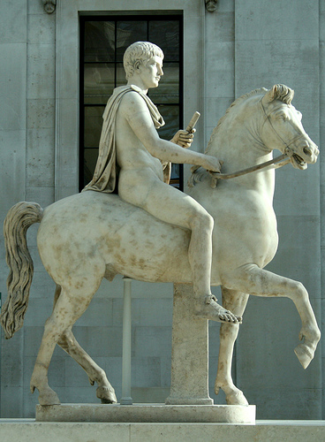
Equestrians
Ranking immediately below senators, equestrians became an important _______ _______________, whose work was key to the smooth running of the Roman Empire.

Slide 58
Equestrians
Ranking immediately below senators, equestrians became an important human resource, whose work was key to the smooth running of the Roman Empire.

Slide 59
Equestrians
Ranking immediately below senators, equestrians became an important human
resource, whose work was key to the smooth running of the Roman Empire.
As its name suggests, the equestrian class was originally composed of the
________________. In 218 BCE, equestrians took on more
________ related roles when Senators were prevented
from becoming involved in trade or business.

Slide 60
Equestrians
Ranking immediately below senators, equestrians became an important human
resource, whose work was key to the smooth running of the Roman Empire.
As its name suggests, the equestrian class was originally composed of the
Roman Calvary. In 218 BCE, equestrians took on more
________ related roles when Senators were prevented
from becoming involved in trade or business.

Slide 61
Equestrians
Ranking immediately below senators, equestrians became an important human
resource, whose work was key to the smooth running of the Roman Empire.
As its name suggests, the equestrian class was originally composed of the
Roman Calvary. In 218 BCE, equestrians took on more
business related roles when Senators were prevented
from becoming involved in trade or business.

Slide 62
Equestrians
Ranking immediately below senators, equestrians became an important human
resource, whose work was key to the smooth running of the Roman Empire.
As its name suggests, the equestrian class was originally composed of the
Roman calvary. In 218 BCE, equestrians took on more
business related roles when Senators were prevented
from becoming involved in trade or business.
As a result, many in the equestrian class became
_______________________. Many were tax collectors,
_______, miners and exporters, while others managed
things like road building and ___________.

Slide 63
Equestrians
Ranking immediately below senators, equestrians became an important human
resource, whose work was key to the smooth running of the Roman Empire.
As its name suggests, the equestrian class was originally composed of the
Roman calvary. In 218 BCE, equestrians took on more
business related roles when Senators were prevented
from becoming involved in trade or business.
As a result, many in the equestrian class became
wealthy businessman. Many were tax collectors,
_______, miners and exporters, while others managed
things like road building and ___________.

Slide 64
Equestrians
Ranking immediately below senators, equestrians became an important human
resource, whose work was key to the smooth running of the Roman Empire.
As its name suggests, the equestrian class was originally composed of the
Roman calvary. In 218 BCE, equestrians took on more
business related roles when Senators were prevented
from becoming involved in trade or business.
As a result, many in the equestrian class became
wealthy businessman. Many were tax collectors,
bankers, miners and exporters, while others managed
things like road building and ___________.

Slide 65
Equestrians
Ranking immediately below senators, equestrians became an important human
resource, whose work was key to the smooth running of the Roman Empire.
As its name suggests, the equestrian class was originally composed of the
Roman calvary. In 218 BCE, equestrians took on more
business related roles when Senators were prevented
from becoming involved in trade or business.
As a result, many in the equestrian class became
wealthy businessman. Many were tax collectors,
bankers, miners and exporters, while others managed
things like road building and construction.

Slide 66
Equestrians
Ranking immediately below senators, equestrians became an important human
resource, whose work was key to the smooth running of the Roman Empire.
As its name suggests, the equestrian class was originally composed of the
Roman calvary. In 218 BCE, equestrians took on more
business related roles when Senators were prevented
from becoming involved in trade or business.
As a result, many in the equestrian class became
wealthy businessmen. Many were tax collectors,
bankers, miners and exporters, while others managed
things like road building and construction.
Even though they could gain some wealth, they could
________________ to become patricians.

Slide 67
Equestrians
Ranking immediately below senators, equestrians became an important human
resource, whose work was key to the smooth running of the Roman Empire.
As its name suggests, the equestrian class was originally composed of the
Roman calvary. In 218 BCE, equestrians took on more
business related roles when Senators were prevented
from becoming involved in trade or business.
As a result, many in the equestrian class became
wealthy businessmen. Many were tax collectors,
bankers, miners and exporters, while others managed
things like road building and construction.
Even though they could gain some wealth, they could
not move up to become patricians.

Slide 68
Emperors
Patricians & Senators
Equestrians
Plebeians
Social
Hierarchy

Slide 69
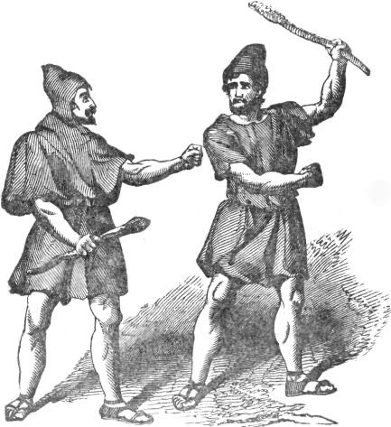
Plebeians
Rome’s ________ class, the plebeians, had little ________power.
Grouped together, however, they became a Roman ___ and had to be
handled carefully.

Slide 70
Plebeians
Rome’s working class, the plebeians, had little ________power.
Grouped together, however, they became a Roman ___ and had to be
handled carefully.

Slide 71
Plebeians
Rome’s working class, the plebeians, had little individual power.
Grouped together, however, they became a Roman _____ and had to
be handled carefully.

Slide 72
Plebeians
Rome’s working class, the plebeians, had little individual power.
Grouped together, however, they became a Roman mob and had to
be handled carefully.

Slide 73
Plebeians
Rome’s working class, the plebeians had little individual power.
Grouped together, however, they became a Roman mob and had to
be handled carefully.
By the first century CE, plebeians comprised a formal class, which held
its own _______, elected its own _________ and kept its own records.

Slide 74
Plebeians
Rome’s working class, the plebeians had little individual power.
Grouped together, however, they became a Roman mob and had to
be handled carefully.
By the first century CE, plebeians comprised a formal class, which held
its own meetings, elected its own _________ and kept its own records.

Slide 75
Plebeians
Rome’s working class, the plebeians had little individual power.
Grouped together, however, they became a Roman mob and had to
be handled carefully.
By the first century CE, plebeians comprised a formal class, which held
its own meetings, elected its own officials and kept its own records.

Slide 76
Plebeians
Rome’s working class, the plebeians had little individual power.
Grouped together, however, they became a Roman mob and had to
be handled carefully.
By the first century CE, plebeians comprised a formal class, which held
its own meetings, elected its own officials and kept its own records.
The term plebeian referred to all _____ Roman
citizens who were not members of the
patrician or equestrian classes.

Slide 77
Plebeians
Rome’s working class, the plebeians had little individual power.
Grouped together, however, they became a Roman mob and had to
be handled carefully.
By the first century CE, plebeians comprised a formal class, which held
its own meetings, elected its own officials and kept its own records.
The term plebeian referred to all free Roman
citizens who were not members of the
patrician or equestrian classes.

Slide 78
Plebeians
Rome’s working class, the plebeians had little individual power.
Grouped together, however, they became a Roman mob and had to
be handled carefully.
By the first century CE, plebeians comprised a formal class, which held
its own meetings, elected its own officials and kept its own records.
The term plebeian referred to all free Roman
citizens who were not members of the
patrician or equestrian classes.
Plebeians were average working citizens of
Rome – _______, ______, builders or
craftsmen – who worked hard to support
their families and pay their _____.

Slide 79
Plebeians
Rome’s working class, the plebeians had little individual power.
Grouped together, however, they became a Roman mob and had to
be handled carefully.
By the first century CE, plebeians comprised a formal class, which held
its own meetings, elected its own officials and kept its own records.
The term plebeian referred to all free Roman
citizens who were not members of the
patrician or equestrian classes.
Plebeians were average working citizens of
Rome – farmers, ______, builders or
craftsmen – who worked hard to support
their families and pay their _____.

Slide 80
Plebeians
Rome’s working class, the plebeians had little individual power.
Grouped together, however, they became a Roman mob and had to
be handled carefully.
By the first century CE, plebeians comprised a formal class, which held
its own meetings, elected its own officials and kept its own records.
The term plebeian referred to all free Roman
citizens who were not members of the
patrician or equestrian classes.
Plebeians were average working citizens of
Rome – farmers, bakers, builders or
craftsmen – who worked hard to support
their families and pay their _____.

Slide 81
Plebeians
Rome’s working class, the plebeians had little individual power.
Grouped together, however, they became a Roman mob and had to
be handled carefully.
By the first century CE, plebeians comprised a formal class, which held
its own meetings, elected its own officials and kept its own records.
The term plebeian referred to all free Roman
citizens who were not members of the
patrician or equestrian classes.
Plebeians were average working citizens of
Rome – farmers, bakers, builders or
craftsmen – who worked hard to support
their families and pay their taxes.

Slide 82
Emperors
Patricians & Senators
Equestrians
Plebeians
Freedmen & Soldiers
Social
Hierarchy

Slide 83
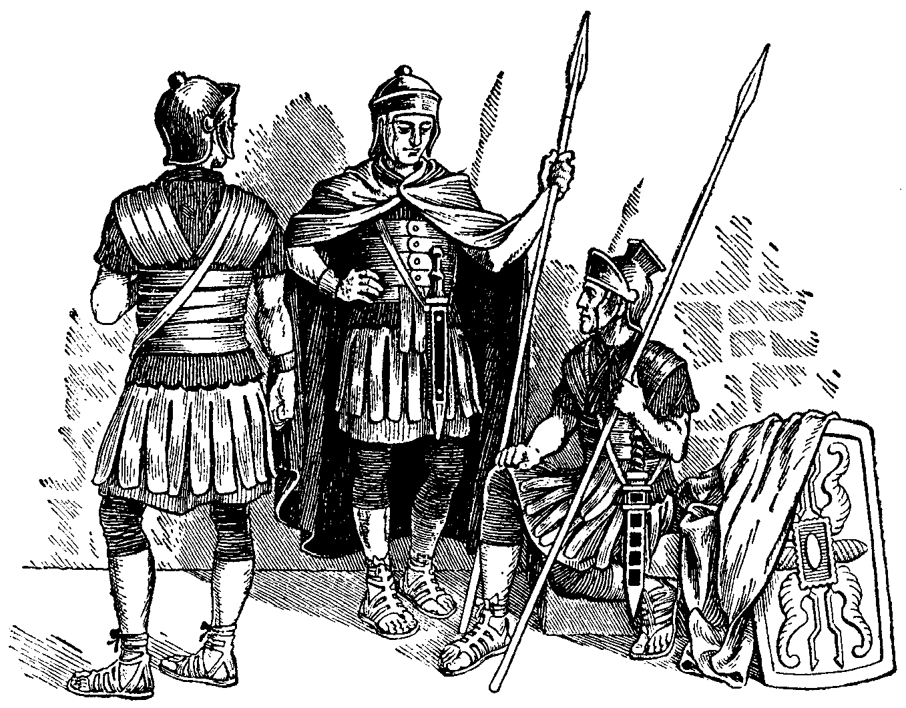
Soldiers
The Roman Army was one of the
most __________ in the history of the
world and its soldiers were rightly
feared for their training, discipline, and _________. As a result, the
army was a major player in Roman politics and maintaining its
________ was important for any Emperor.

Slide 84
Soldiers
The Roman Army was one of the
most successful in the history of the
world and its soldiers were rightly
feared for their training, discipline, and _________. As a result, the
army was a major player in Roman politics and maintaining its
________ was important for any Emperor.

Slide 85
Soldiers
The Roman Army was one of the
most successful in the history of the
world and its soldiers were rightly
feared for their training, discipline, and stamina. As a result, the
army was a major player in Roman politics and maintaining its
________ was important for any Emperor.

Slide 86
Soldiers
The Roman Army was one of the
most successful in the history of the
world and its soldiers were rightly
feared for their training, discipline, and stamina. As a result, the
army was a major player in Roman politics and maintaining its
loyalty was important for any Emperor.

Slide 87
Soldiers
The Roman Army was one of the
most successful in the history of the
world and its soldiers were rightly
feared for their training, discipline, and stamina. As a result, the
army was a major player in Roman politics and maintaining its
loyalty was important for any Emperor.
The Roman _______ – The Roman Empire was created and controlled
by its soldiers. At the core of the army its legions, who were highly
skilled in their training, discipline, and ________________.

Slide 88
Soldiers
The Roman Army was one of the
most successful in the history of the
world and its soldiers were rightly
feared for their training, discipline, and stamina. As a result, the
army was a major player in Roman politics and maintaining its
loyalty was important for any Emperor.
The Roman legions - The Roman Empire was created and controlled
by its soldiers. At the core of the army its legions, who were highly
skilled in their training, discipline, and ________________.

Slide 89
Soldiers
The Roman Army was one of the
most successful in the history of the
world and its soldiers were rightly
feared for their training, discipline, and stamina. As a result, the
army was a major player in Roman politics and maintaining its
loyalty was important for any Emperor.
The Roman legions - The Roman Empire was created and controlled
by its soldiers. At the core of the army its legions, who were highly
skilled in their training, discipline, and fighting ability.

Slide 90
Soldiers
The Roman Army was one of the
most successful in the history of the
world and its soldiers were rightly
feared for their training, discipline, and stamina. As a result, the
army was a major player in Roman politics and maintaining its
loyalty was important for any Emperor.
The Roman legions – The Roman Empire was created and controlled
by its soldiers. At the core of the army its legions, who were highly
skilled in their training, discipline, and fighting ability.
The minimum term of service for a soldier during the first century CE
was __ years.

Slide 91
Soldiers
The Roman Army was one of the
most successful in the history of the
world and its soldiers were rightly
feared for their training, discipline, and stamina. As a result, the
army was a major player in Roman politics and maintaining its
loyalty was important for any Emperor.
The Roman legions – The Roman Empire was created and controlled
by its soldiers. At the core of the army its legions, who were highly
skilled in their training, discipline, and fighting ability.
The minimum term of service for a soldier during the first century CE
was 20 years.

Slide 92
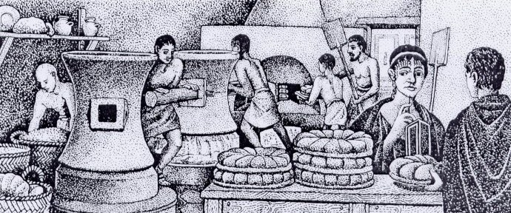
Freedmen
Once freed, former slaves could work in the same jobs as
plebeians – as craftsmen, midwives, or _________ . Some even
became wealthy.

Slide 93
Freedmen
Once freed, former slaves could work in the same jobs as
plebeians – as craftsmen, midwives, or traders. Some even
became wealthy.

Slide 94
Freedmen
Once freed, former slaves could work in the same jobs as
plebeians – as craftsmen, midwives, or traders. Some even
became wealthy.
However, Rome’s society attached importance to social
status and even successful freedmen usually found that
their past _______ was hard to overcome – people in the
higher classes still looked down on them and treated them
______.

Slide 95
Freedmen
Once freed, former slaves could work in the same jobs as
plebeians – as craftsmen, midwives, or traders. Some even
became wealthy.
However, Rome’s society attached importance to social
status and even successful freedmen usually found that
their past slavery was hard to overcome – people in the
higher classes still looked down on them and treated them
______.

Slide 96
Freedmen
Once freed, former slaves could work in the same jobs as
plebeians – as craftsmen, midwives, or traders. Some even
became wealthy.
However, Rome’s society attached importance to social
status and even successful freedmen usually found that
their past slavery was hard to overcome – people in the
higher classes still looked down on them and treated them
poorly.

Slide 97
Emperors
Patricians & Senators
Equestrians
Plebeians
Soldiers & Freedmen
Women, Gladiators, & Slaves
Social
Hierarchy

Slide 98
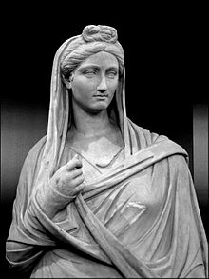
Women
Defined by the men in their lives, women in ancient Rome
were valued mainly as _________________. Although
some were allowed more freedom than others, there was
always a limit, even for the ________ of an emperor.

Slide 99
Women
Defined by the men in their lives, women in ancient Rome
were valued mainly as wives and mothers. Although
some were allowed more freedom than others, there was
always a limit, even for the ________ of an emperor.

Slide 100
Women
Defined by the men in their lives, women in ancient Rome
were valued mainly as wives and mothers. Although
some were allowed more freedom than others, there was
always a limit, even for the daughter of an emperor.

Slide 101
Women
Defined by the men in their lives, women in ancient Rome
were valued mainly as wives and mothers. Although
some were allowed more freedom than others, there was
always a limit, even for the daughter of an emperor.
Not much information exists about Roman women in the
first century. Women were not allowed to be active in
________, so nobody wrote about them. Neither were they
taught how to _____, so they could not tell their own
stories.

Slide 102
Women
Defined by the men in their lives, women in ancient Rome
were valued mainly as wives and mothers. Although
some were allowed more freedom than others, there was
always a limit, even for the daughter of an emperor.
Not much information exists about Roman women in the
first century. Women were not allowed to be active in
politics, so nobody wrote about them. Neither were they
taught how to _____, so they could not tell their own
stories.

Slide 103
Women
Defined by the men in their lives, women in ancient Rome
were valued mainly as wives and mothers. Although
some were allowed more freedom than others, there was
always a limit, even for the daughter of an emperor.
Not much information exists about Roman women in the
first century. Women were not allowed to be active in
politics, so nobody wrote about them. Neither were they
taught how to write, so they could not tell their own
stories.

Slide 104
Women
Defined by the men in their lives, women in ancient Rome
were valued mainly as wives and mothers. Although
some were allowed more freedom than others, there was
always a limit, even for the daughter of an emperor.
Not much information exists about Roman women in the
first century. Women were not allowed to be active in
politics, so nobody wrote about them. Neither were they
taught how to write, so they could not tell their own
stories.
Legal Rights – Unlike society in ancient Egypt, Rome did
not regard women as _____ to men before the law. They
received only a basic _________, if any at all, and were
subject to the _________ of a man.

Slide 105
Women
Defined by the men in their lives, women in ancient Rome
were valued mainly as wives and mothers. Although
some were allowed more freedom than others, there was
always a limit, even for the daughter of an emperor.
Not much information exists about Roman women in the
first century. Women were not allowed to be active in
politics, so nobody wrote about them. Neither were they
taught how to write, so they could not tell their own
stories.
Legal Rights – Unlike society in ancient Egypt, Rome did
not regard women as equal to men before the law. They
received only a basic _________, if any at all, and were
subject to the _________ of a man.

Slide 106
Women
Defined by the men in their lives, women in ancient Rome
were valued mainly as wives and mothers. Although
some were allowed more freedom than others, there was
always a limit, even for the daughter of an emperor.
Not much information exists about Roman women in the
first century. Women were not allowed to be active in
politics, so nobody wrote about them. Neither were they
taught how to write, so they could not tell their own
stories.
Legal Rights – Unlike society in ancient Egypt, Rome did
not regard women as equal to men before the law. They
received only a basic education, if any at all, and were
subject to the _________ of a man.

Slide 107
Women
Defined by the men in their lives, women in ancient Rome
were valued mainly as wives and mothers. Although
some were allowed more freedom than others, there was
always a limit, even for the daughter of an emperor.
Not much information exists about Roman women in the
first century. Women were not allowed to be active in
politics, so nobody wrote about them. Neither were they
taught how to write, so they could not tell their own
stories.
Legal Rights – Unlike society in ancient Egypt, Rome did
not regard women as equal to men before the law. They
received only a basic education, if any at all, and were
subject to the authority of a man.

Slide 108
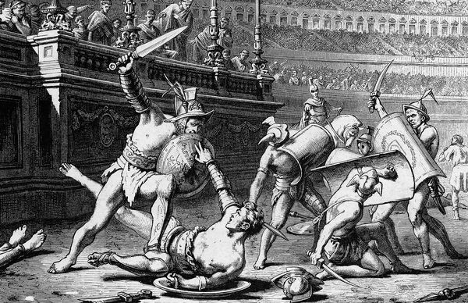
Gladiators
Successful gladiators were the ___________ of the first century.
Bloody, brutal but popular, gladiator matches are often seen
as the dark side of Roman civilization. Gladiators were one particular
class of ______.

Slide 109
Gladiators
Successful gladiators were the movie stars of the first century.
Bloody, brutal but popular, gladiator matches are often seen
as the dark side of Roman civilization. Gladiators were one particular
class of ______.

Slide 110
Gladiators
Successful gladiators were the movie stars of the first century.
Bloody, brutal but popular, gladiator matches are often seen
as the dark side of Roman civilization. Gladiators were one particular
class of slaves.

Slide 111
Gladiators
Successful gladiators were the movie stars of the first century.
Bloody, brutal but popular, gladiator matches are often seen
as the dark side of Roman civilization. Gladiators were one particular
class of slaves.
Ceremonial, public violence had been a favorite _____________ of the Romans for
centuries. The practice began as an ancient Etruscan _______ ritual: when a tribal
chief died, his warriors would make a blood sacrifice to his spirit by fighting to
the death by his tomb.

Slide 112
Gladiators
Successful gladiators were the movie stars of the first century.
Bloody, brutal but popular, gladiator matches are often seen
as the dark side of Roman civilization. Gladiators were one particular
class of slaves.
Ceremonial, public violence had been a favorite entertainment of the Romans for
centuries. The practice began as an ancient Etruscan _______ ritual: when a tribal
chief died, his warriors would make a blood sacrifice to his spirit by fighting to
the death by his tomb.

Slide 113
Gladiators
Successful gladiators were the movie stars of the first century.
Bloody, brutal but popular, gladiator matches are often seen
as the dark side of Roman civilization. Gladiators were one particular
class of slaves.
Ceremonial, public violence had been a favorite entertainment of the Romans for
centuries. The practice began as an ancient Etruscan funeral ritual: when a tribal
chief died, his warriors would make a blood sacrifice to his spirit by fighting to
the death by his tomb.

Slide 114
Gladiators
Successful gladiators were the movie stars of the first century.
Bloody, brutal but popular, gladiator matches are often seen
as the dark side of Roman civilization. Gladiators were one particular
class of slaves.
Ceremonial, public violence had been a favorite entertainment of the Romans for
centuries. The practice began as an ancient Etruscan funeral ritual: when a tribal
chief died, his warriors would make a blood sacrifice to his spirit by fighting to
the death by his tomb.
This changed over time. The nobility began to put on gladiator shows in
memory of the _____ and by the time _____________ was in charge, these
exhibitions had become public spectacles.

Slide 115
Gladiators
Successful gladiators were the movie stars of the first century.
Bloody, brutal but popular, gladiator matches are often seen
as the dark side of Roman civilization. Gladiators were one particular
class of slaves.
Ceremonial, public violence had been a favorite entertainment of the Romans for
centuries. The practice began as an ancient Etruscan funeral ritual: when a tribal
chief died, his warriors would make a blood sacrifice to his spirit by fighting to
the death by his tomb.
This changed over time. The nobility began to put on gladiator shows in
memory of the dead and by the time _____________ was in charge, these
exhibitions had become public spectacles.

Slide 116
Gladiators
Successful gladiators were the movie stars of the first century.
Bloody, brutal but popular, gladiator matches are often seen
as the dark side of Roman civilization. Gladiators were one particular
class of slaves.
Ceremonial, public violence had been a favorite entertainment of the Romans for
centuries. The practice began as an ancient Etruscan funeral ritual: when a tribal
chief died, his warriors would make a blood sacrifice to his spirit by fighting to
the death by his tomb.
This changed over time. The nobility began to put on gladiator shows in
memory of the dead and by the time Julius Caesar was in charge, these
exhibitions had become public spectacles.

Slide 117
Gladiators
Successful gladiators were the movie stars of the first century.
Bloody, brutal but popular, gladiator matches are often seen
as the dark side of Roman civilization. Gladiators were one particular
class of slaves.
Ceremonial, public violence had been a favorite entertainment of the Romans for
centuries. The practice began as an ancient Etruscan funeral ritual: when a tribal
chief died, his warriors would make a blood sacrifice to his spirit by fighting to
the death by his tomb.
This changed over time. The nobility began to put on gladiator shows in
memory of the dead and by the time Julius Caesar was in charge, these
exhibitions had become public spectacles.
Organized games - The games took place in ____________. Gladiators would
be sent to the arena to fight to the death before cheering crowds of _________.
As the contests became more organized gladiators became more ___________.

Slide 118
Gladiators
Successful gladiators were the movie stars of the first century.
Bloody, brutal but popular, gladiator matches are often seen
as the dark side of Roman civilization. Gladiators were one particular
class of slaves.
Ceremonial, public violence had been a favorite entertainment of the Romans for
centuries. The practice began as an ancient Etruscan funeral ritual: when a tribal
chief died, his warriors would make a blood sacrifice to his spirit by fighting to
the death by his tomb.
This changed over time. The nobility began to put on gladiator shows in
memory of the dead and by the time Julius Caesar was in charge, these
exhibitions had become public spectacles.
Organized games - The games took place in amphitheaters. Gladiators would
be sent to the arena to fight to the death before cheering crowds of _________.
As the contests became more organized gladiators became more ___________.

Slide 119
Gladiators
Successful gladiators were the movie stars of the first century.
Bloody, brutal but popular, gladiator matches are often seen
as the dark side of Roman civilization. Gladiators were one particular
class of slaves.
Ceremonial, public violence had been a favorite entertainment of the Romans for
centuries. The practice began as an ancient Etruscan funeral ritual: when a tribal
chief died, his warriors would make a blood sacrifice to his spirit by fighting to
the death by his tomb.
This changed over time. The nobility began to put on gladiator shows in
memory of the dead and by the time Julius Caesar was in charge, these
exhibitions had become public spectacles.
Organized games - The games took place in amphitheaters. Gladiators would
be sent to the arena to fight to the death before cheering crowds of thousands.
As the contests became more organized gladiators became more ___________.

Slide 120
Gladiators
Successful gladiators were the movie stars of the first century.
Bloody, brutal but popular, gladiator matches are often seen
as the dark side of Roman civilization. Gladiators were one particular
class of slaves.
Ceremonial, public violence had been a favorite entertainment of the Romans for
centuries. The practice began as an ancient Etruscan funeral ritual: when a tribal
chief died, his warriors would make a blood sacrifice to his spirit by fighting to
the death by his tomb.
This changed over time. The nobility began to put on gladiator shows in
memory of the dead and by the time Julius Caesar was in charge, these
exhibitions had become public spectacles.
Organized games - The games took place in amphitheaters. Gladiators would
be sent to the arena to fight to the death before cheering crowds of thousands.
As the contests became more organized gladiators became more specialized.

Slide 121
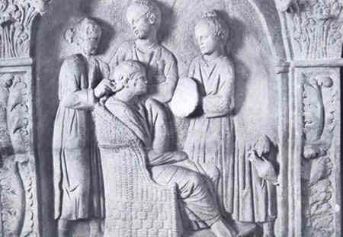
Slaves
The most unfortunate slaves were the ______, who were worked often to the point of _____ by their owners.

Slide 122
Slaves
The most unfortunate slaves were the miners, who were worked often to the point of _____ by their owners.

Slide 123
Slaves
The most unfortunate slaves were the miners, who were worked often to the point of death by their owners.

Slide 124
Slaves
The most unfortunate slaves were the miners, who were worked often to the point of death by their owners.
Some slaves were a part of the ____________, or domestic ________ who worked in the households of more wealthy families.

Slide 125
Slaves
The most unfortunate slaves were the miners, who were worked often to the point of death by their owners.
Some slaves were a part of the police force, or domestic ________ who worked in the households of more wealthy families.

Slide 126
Slaves
The most unfortunate slaves were the miners, who were worked often to the point of death by their owners.
Some slaves were a part of the police force, or domestic servants who worked in the households of more wealthy families.

Slide 127
Slaves
The most unfortunate slaves were the miners, who were worked often to the point of death by their owners.
Some slaves were a part of the police force, or domestic servants who worked in the households of more wealthy families.
Sometimes, enslaved people ________ and tried to escape.

Slide 128
Slaves
The most unfortunate slaves were the miners, who were worked often to the point of death by their owners.
Some slaves were a part of the police force, or domestic servants who worked in the households of more wealthy families.
Sometimes, enslaved people rebelled and tried to escape.

Slide 129
Slaves
The most unfortunate slaves were the miners, who were worked often to the point of death by their owners.
Some slaves were a part of the police force, or domestic servants who worked in the households of more wealthy families.
Sometimes, enslaved people rebelled and tried to escape.
You will also find information from your graphic organizers/notes pertaining to the articles we read.

Slide 130
Hierarchy Project:
10 categories in the pyramid (30 points)
10 pictures (1 pt. each)
10 descriptions (2 sentences at least, 2 pts. each)
Title, Creativity, NEATNESS, spelling, punctuation, etc… (10 points)
Total Project: 40 points

